Slide 1
My Capstone Project
Final presentation

Slide 2
Introduction
The purpose of this project is to help them better understand the Geographical advantages of different districts so that they can have a best choice of all kinds of investments. In addition, the factors on other advantages and disadvantages are considered.

Slide 3
Data used in the project
To make good use of the foursquare location data, the labs done for Toronto segmented and clustered neighborhoods gave me good examples for new ideas.
I would need to leverage the foursquare location data to solve or execute. Data science problems always target an audience and are meant to help a group of stakeholders solve a problem, so make sure that I explicitly describe the audience and why they would care about my problem.
From the results on New York, the lab especially tells 10 most common venues in each district. The data set is about Toronto Venues. After transforming the data to Json files, it is easy to use Pandas to transform them into DataFrame. Then select the required data columns to appear and get the information we want. Geopy library is used to get the latitude and longitude values. With the locations the maps can be created and we will have a direct understanding of the neighborhoods and the purposed areas. The Folium library is also used to show maps on different requirements.
Finally, different analysis on Toronto will give us the related better data to open a company and choose a good place to resident in. And I hope my analysis will do good for them.

Slide 4
Methodology
First of all, the Foursquare API was utilized because basic geographical location information and particular venues can be explored through Foursquare API. With a specific credentials client ID and secret, the required foursquare data can be accessed.
Second, Folium is a great visualization library, the map can directly show us the overall shape of the place we want to know. The detailed information on different venues such as restaurants can be seen in a direct way. The investors can have a better understanding of the city of Toronto to choose his properties. People feel free to zoom into the above map, and click on each circle mark to reveal the name of the neighborhood and its respective borough.
Third, Json library is a lightweight data-interchange format. It is easy for humans to read and write. This can easily handle JSON files problems.
Fourth, k-means clustering was used. K-means is vastly used for clustering in many data science applications, especially useful if you need to quickly discover insights from unlabeled data. K-means include customer segmentation, understand what the visitors of a website are trying to accomplish, pattern recognition and data compression. The project mainly utilized its data compression application in real world. On a series dataset, k-means do good for clustering.
Last but not least, basic numpy and pandas libraries are fundamental methods because dataframes are the basic tool to do any calculations or simulations. Also, some basic python languages are better utilized.

Slide 5
Results

Slide 6
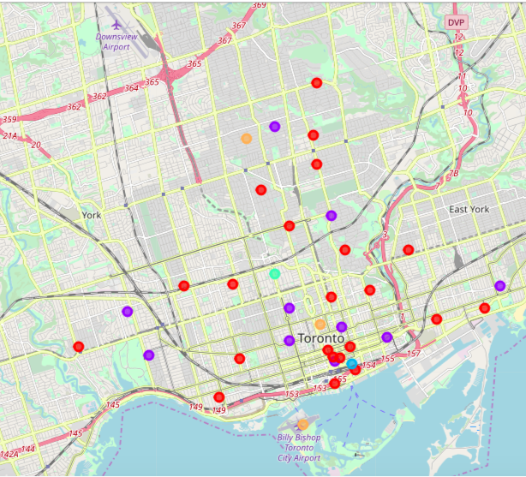
Cluster map
From the clusters map we can see different markers of places in their own clusters. The results showed us top ten common venues in each neighborhood so that the investors will find their preferable places to locate in.

Slide 7
Discussion
From data of top 10 common venues in Toronto, the best place for investors to open a restaurant or start a company should not be one, but also several choices. The data only showed us the current numbers of each kind of venues but no other factors such as cost of the place or environment.
From the clusters map we can see different markers of places in their own clusters. The results showed us top ten common venues in each neighborhood so that the investors will find their preferable places to locate in.
Finally, the investors will compare the several similar venues with less cost and more crowds. The two factors are not concerned in this project but we can estimate from the distribution of top ten common venues in results data from my last part of the notebook.

Slide 8
Conclusion
The investors to open a restaurant in Toronto should consider several factors. One is the data shown in my notebook, that is how many restaurants in different neighborhoods of every districts of Toronto. Second is the crowds of different districts, which depends on the kinds of venues in different areas. If there is more lakes, the number may be small.
The investors should consider the competitive restaurants in the district. Try not to compete with those nearby with more similar kinds of restaurants as yours, that may do bad for the kind of investment. But for start a company, it is good to choose the place with more kinds of restaurants so that you will attract more employees to be hired.

